Slide 1

Feedforward
St. Vincent Pallotti College of Engineering and Technology
DEPARTMENT: COMPUTER SCIENCE & BUSINESS SYSTEMS
Bridging the Gap Between Food Surplus and Hunger
Presented by :-
Sanjivani Shende(46)
Mayuri Anandikar (59)
1

Slide 2
Problem Statement
The Issue at Hand :-
Food Waste: Millions of tons of food are wasted each year.
Hunger Crisis: Despite this, millions of people still suffer from hunger.
Gap: There’s a disconnect between food donors and those in need.
‹#›

Slide 3
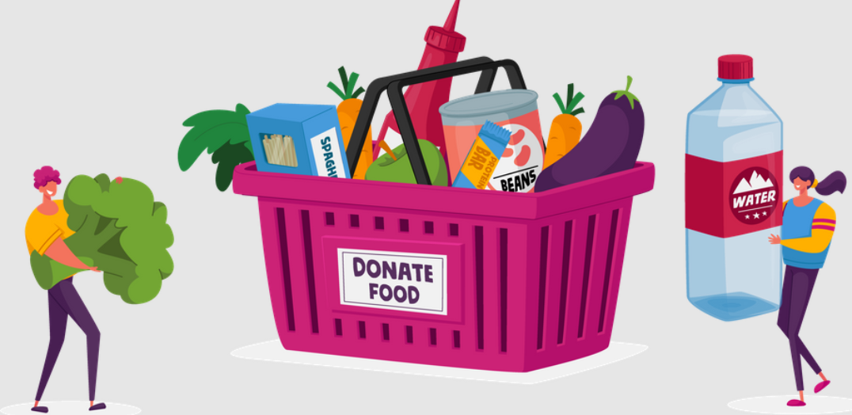
OBJECTIVES AND TARGET
Objectives
Goals for impact
1.Facilitate seamless food donations from individuals and businesses to NGOs.
2. Ensure transparent tracking of food donations and their impact.
3. Promote community participation in reducing hunger and food waste.
1. Reduce food waste- by connecting surplus food to those in need.
2. Enhance food distribution- efficiency through streamlined NGO efforts.
3. Increase community engagement- in combating hunger and promoting sustainability.
Target audience
1. Individuals looking to donate surplus food from their homes or events.
2. Restaurants and food businesses aiming to reduce waste by donating unsold food.
3. NGOs and community organizations focused on distributing food to those in need.
3

Slide 4

Donors: Can post available surplus food on the platform.
NGOs: View and accept donations, schedule pickups, and collaborate with other NGOs.
Community Feature: A donor leaderboard to encourage ongoing participation.
How FeedForward Works
4

Slide 5
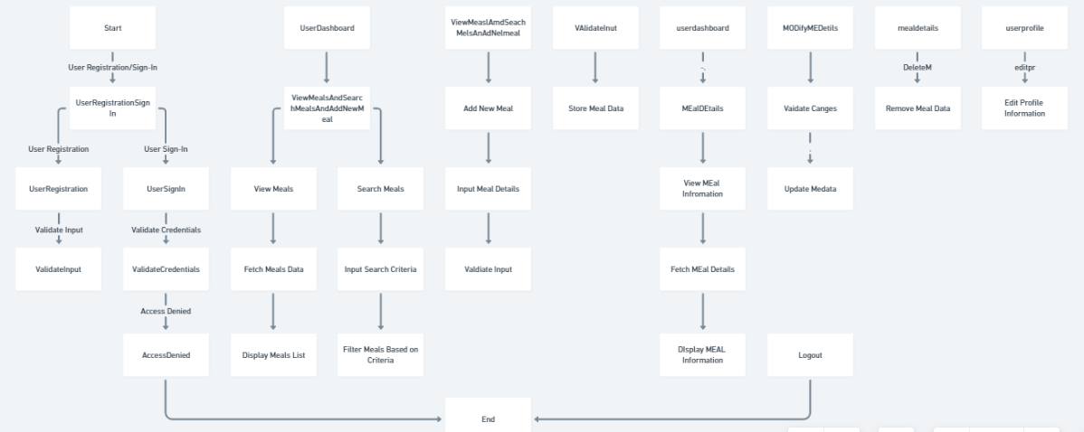
FLOW CHART
5

Slide 6

THANK YOU !
6

